Slide 1
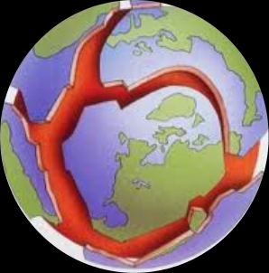
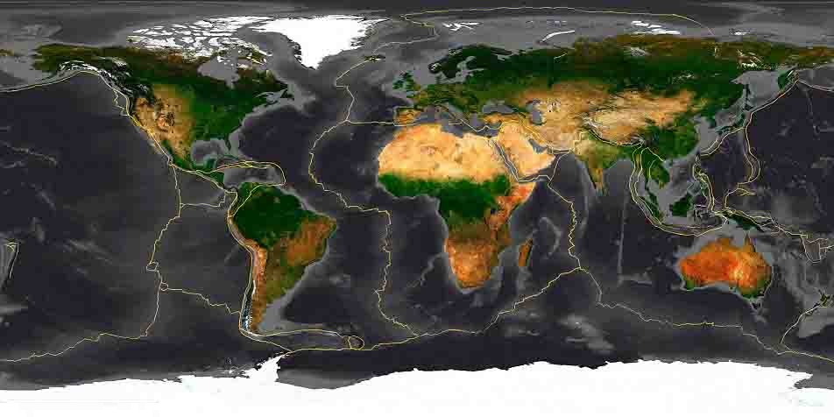
Plate Tectonics
During the 1960s, scientists developed a theory to explain
many of the features on Earth’s surface.
The theory is called plate tectonics and states that Earth’s surface is
broken into large, rigid pieces that move with respect to each other.
These pieces, or tectonic plates, move slowly over Earth’s surface.

Slide 2
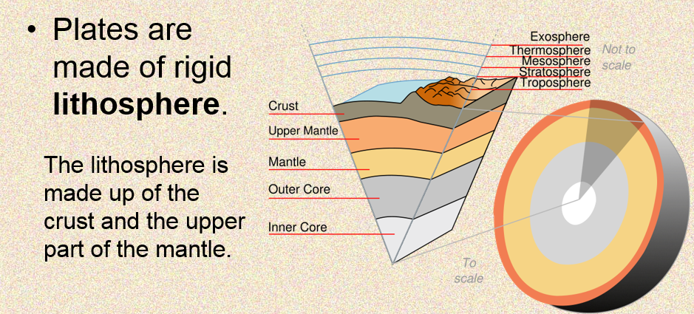
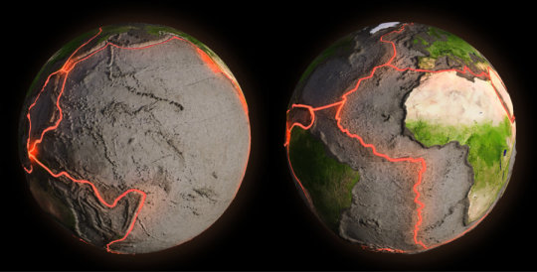
What is a tectonic plate?
The Earth is not a solid ball of rock.
The lithosphere forms a rigid shell on the outside of Earth. The rocks in the lithosphere do not bend easily!
Broken into large pieces - Tectonic plates.

Slide 3
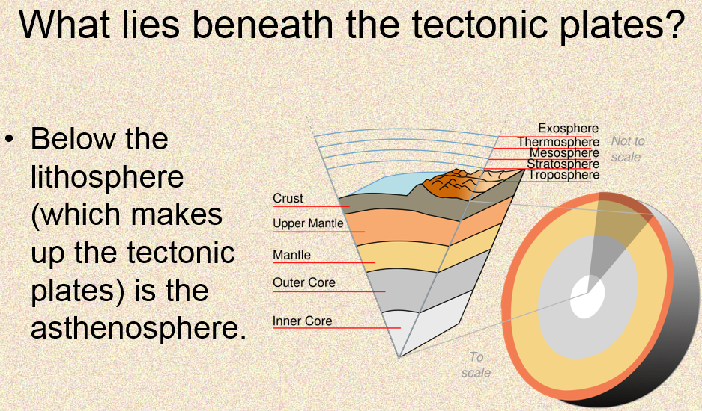

Slide 4
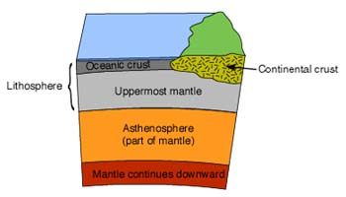
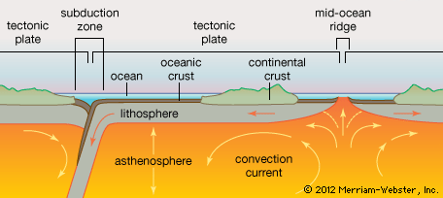
Asthenosphere
The partially melted portion of the mantle below the lithosphere is the asthenosphere.
The asthenosphere is hotter than the lithosphere and can bend more easily.
The ability of the asthenosphere to bend relates to tectonic plate movement.

Slide 5
Lower Mantle & Core
Lower Mantle - Below the asthenosphere
Largest region inside earth
Less flexible than the upper mantle due to high pressure
Magnesium and Iron are found here
Also called the Mesosphere
Earth’s Core – Two Parts
1. Outer Core – Liquid
2. Inner Core – Solid
Both are made mostly of Iron and Nickel

Slide 6
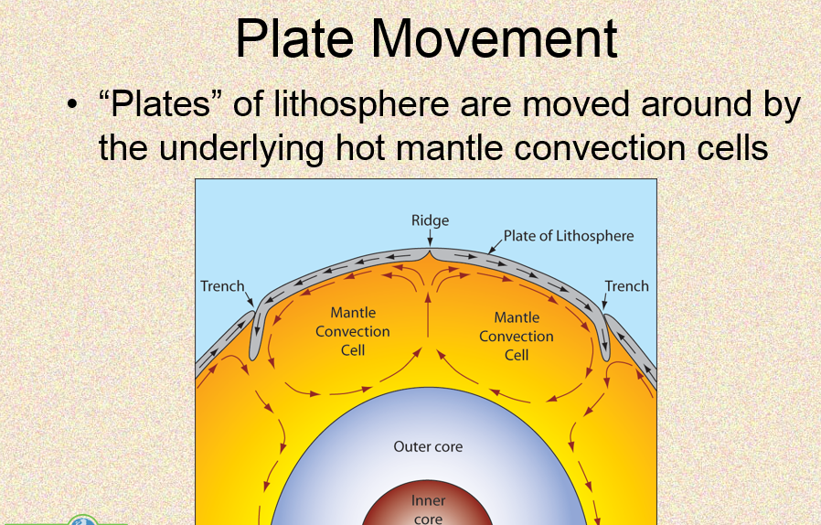

Slide 7
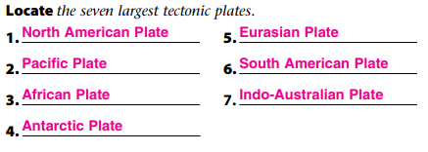
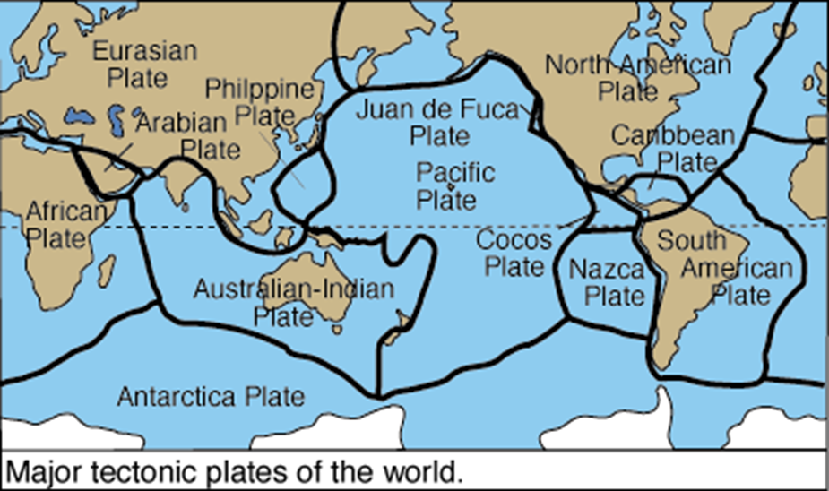
Major Tectonic Plates
There are 15 large tectonic plates within Earth’s Crust
Some are so large they support entire continents.
We live on North American Plate.
Oceans completely cover some plates, such as the Juan de Fuca Plate.
Some plates, such as the North American Plate, are made of both oceanic crust and continental crust

Slide 8
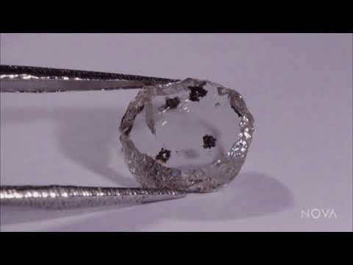

Slide 9
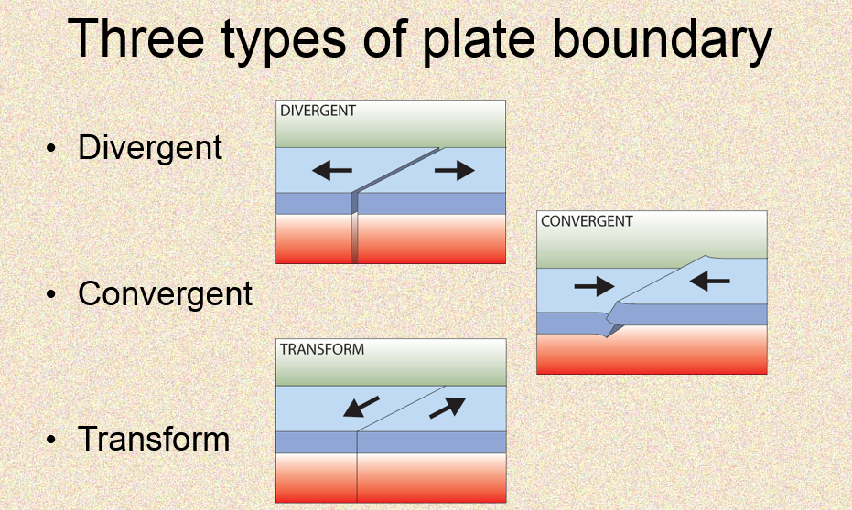
Plate Boundaries
How do scientists describe the movement of a tectonic plate?
They describe a plate’s relative motion — how it moves in relation to another plate.
As plates move relative to each other, different types of boundaries form where the plates meet.
The type of boundary that forms depends on the relative motion of the plates.

Slide 10
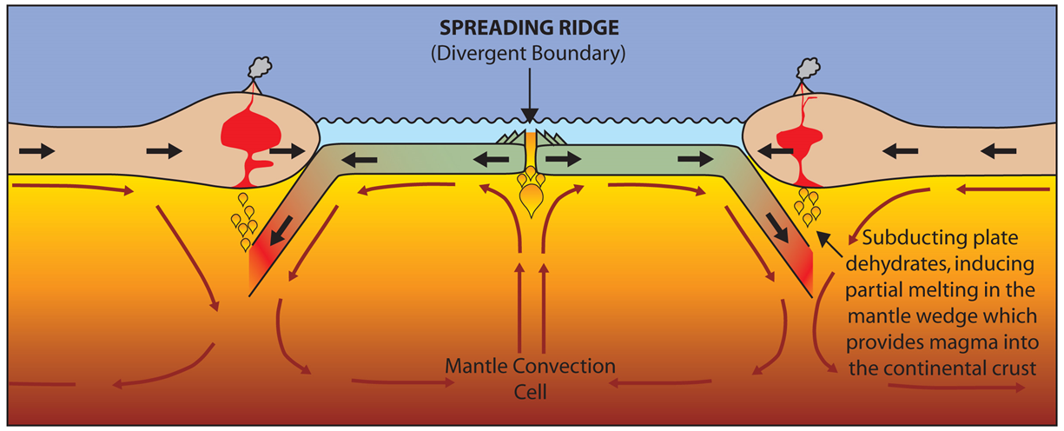
Divergent Boundary
Divergent Boundary – a boundary where two plates move AWAY from each other.
.
As plates move apart new material is erupted to fill the gap

Slide 11
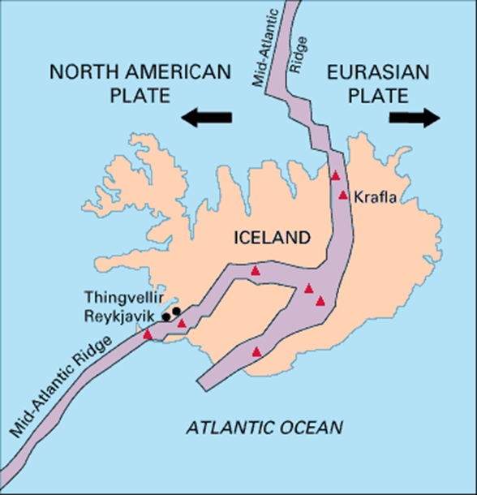
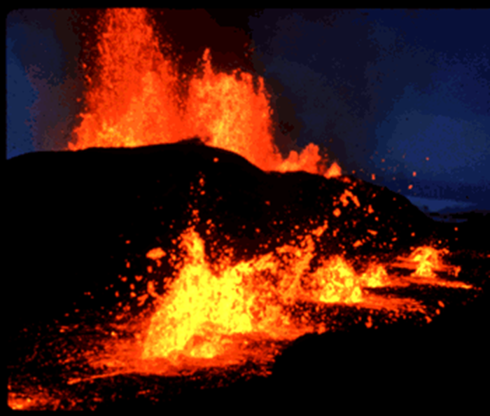
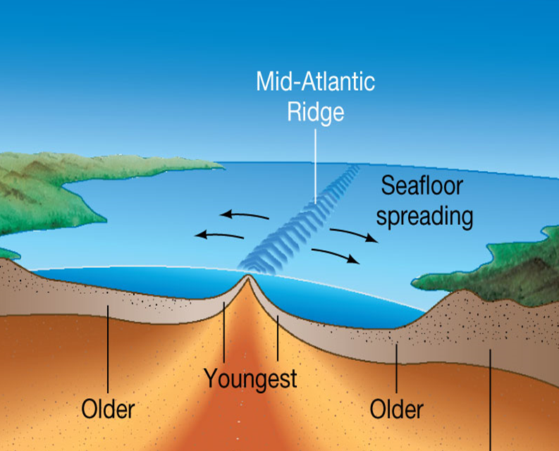
Divergent Boundaries
The boundary between the North American Plate and the Eurasian Plate is a divergent boundary.
As plates move apart, new crust forms between them.
Divergent: Atlantic Ridge

Slide 12
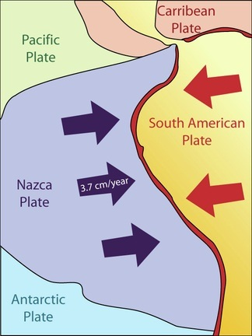
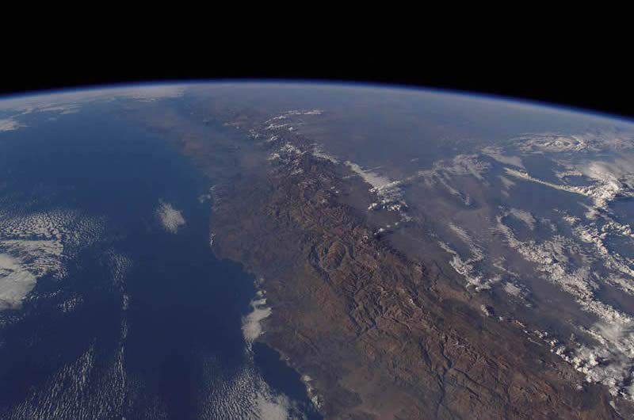
Convergent Boundaries
A boundary where two plates move toward each other is a convergent boundary.
There are three types of convergent plate boundaries:
  1. Continent-continent collision
  2. Continent-oceanic crust collision
  3. Ocean-ocean collision

Slide 13
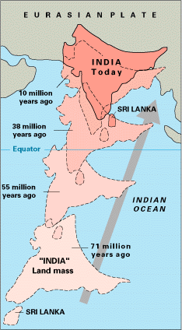
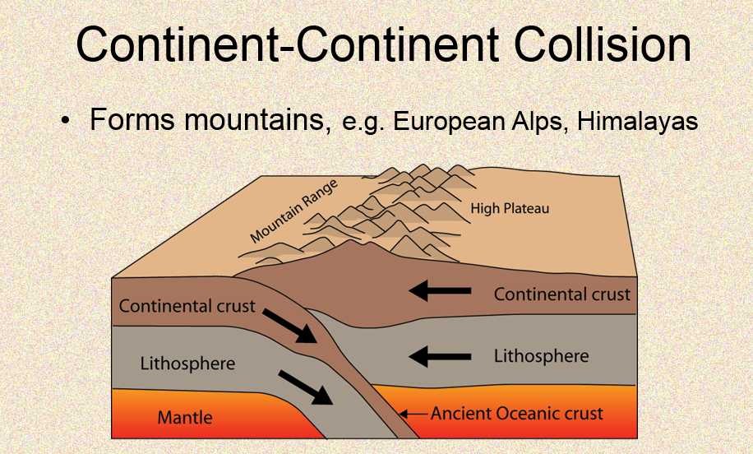
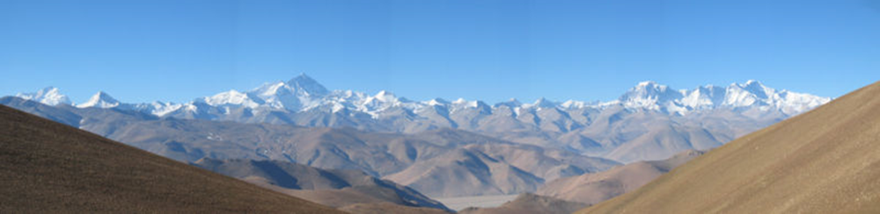
Convergent Boundary:
Example: The Himalayas

Slide 14
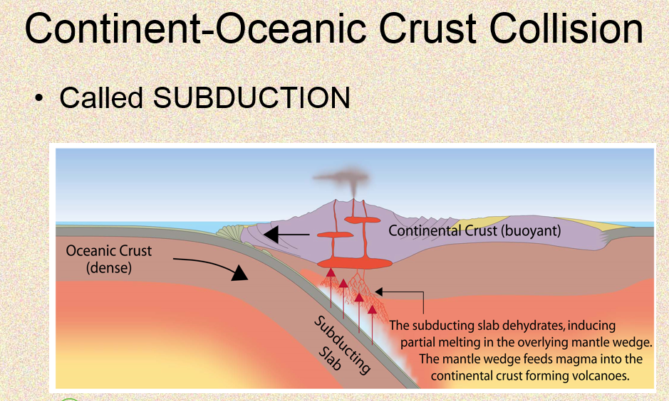
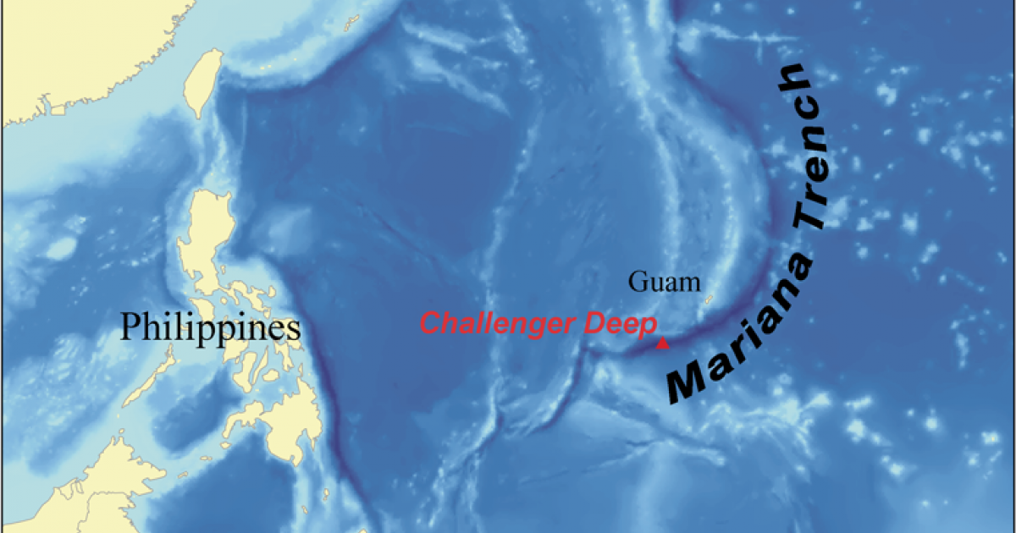
Convergent Boundary - Oceanic to Oceanic
Subduction is the process that occurs when one tectonic plate moves under another tectonic plate.
Example : Marianas Trench
Philippine Plate subducts under Pacific Plate

Slide 15
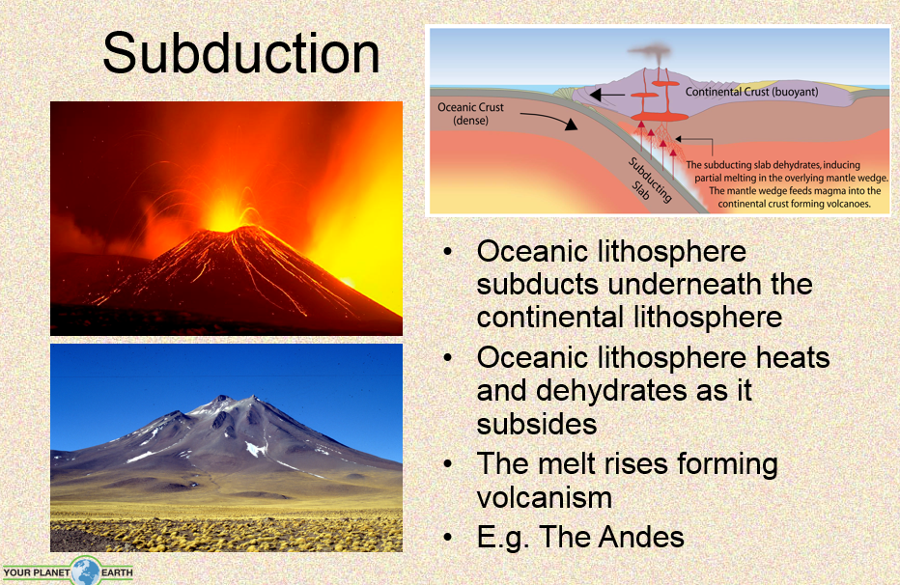

Slide 16
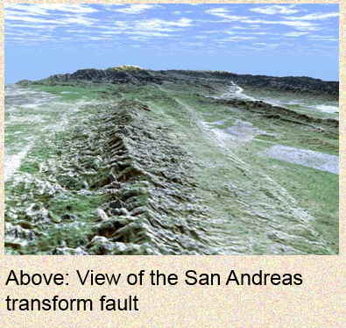
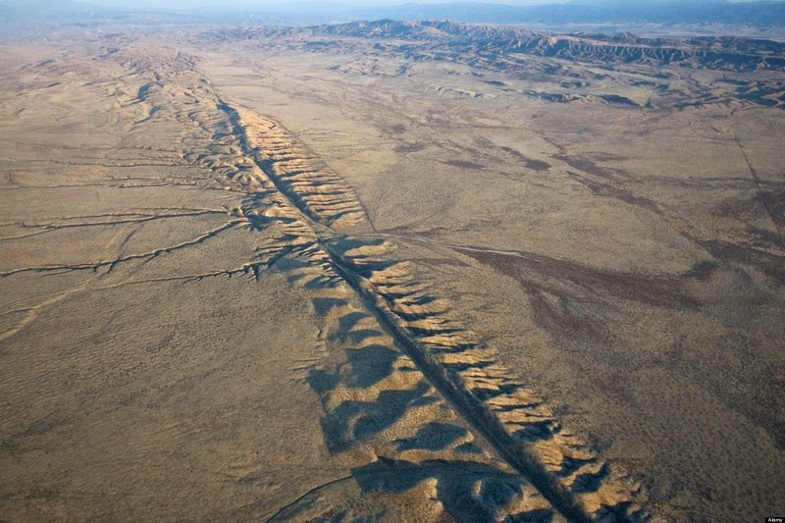
Transform Boundaries
Transform Boundary – When two plates slide past each other.
The boundary between the Pacific Plate and the North American Plate in California is an example of a transform boundary.
San Andreas Fault line is created by this boundary.

Slide 17
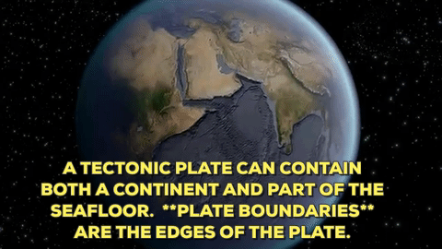
Plate Motion
Tectonic plates move horizontally over Earth’s surface.
The plates move so slowly that geologists could not measure their movement before the mid-twentieth century.
The position of any point on Earth’s surface can be accurately measured using the network of satellites known as the Global Positioning System (GPS).
This technology has determined that North America is separating from Europe at an average rate of just 2.5 cm/yr.
By tracking tectonic plate positions over several years, scientists can measure the speed and the direction of plate movement.

Slide 18
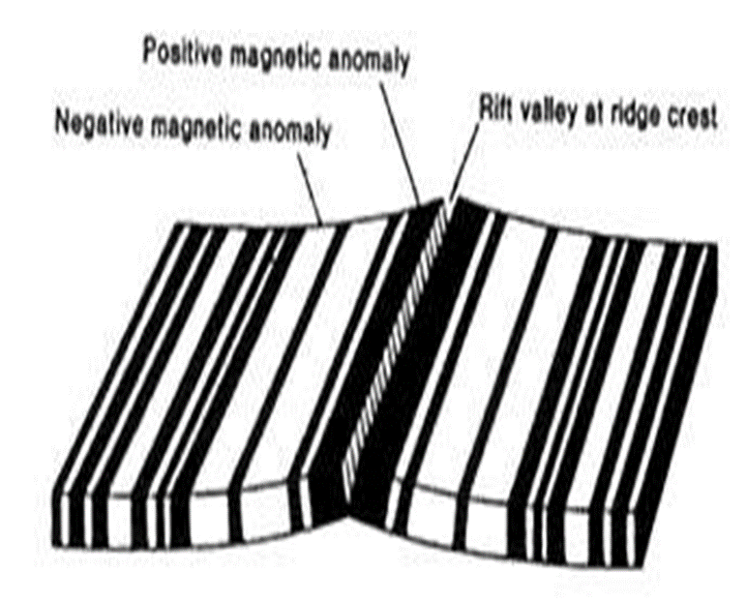
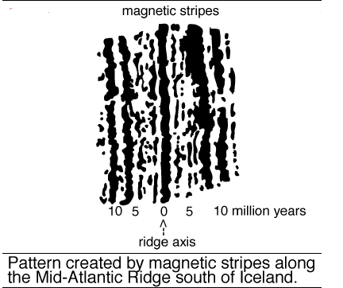
We can measure how fast tectonic plates are moving today, but how do scientists know what the rates of plate movement have been over geologic time?
The oceans hold one of the key pieces to the puzzle. Because the ocean-floor magnetic striping records the flip-flops in the Earth's magnetic field, scientists, knowing the approximate duration of the reversal, can calculate the average rate of plate movement during a given time span.
Evidence from Magnetic Stripes
Rocks that make up the ocean floor lie in a pattern of magnetized stripes which hold a record of the reversals in Earth’s magnetic field

Slide 19
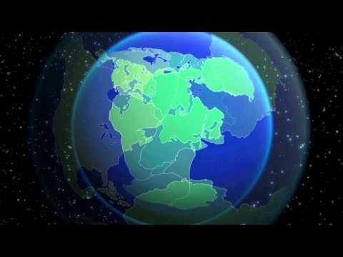
Even though plates move slowly, dramatic changes occur over long periods of time.
North America and Europe once were part of a large continent called Pangaea.
A divergent boundary formed between North America and Europe about 200 million years ago. The plates moved apart, and the Atlantic Ocean formed.

Slide 20
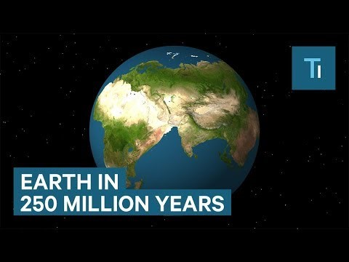

Slide 21
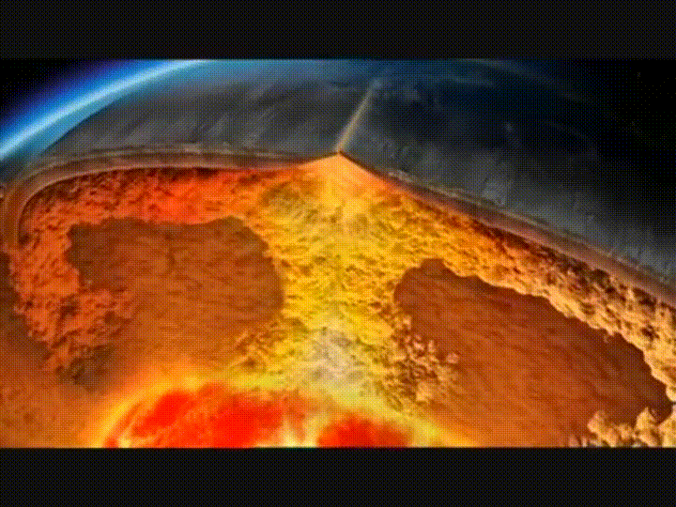
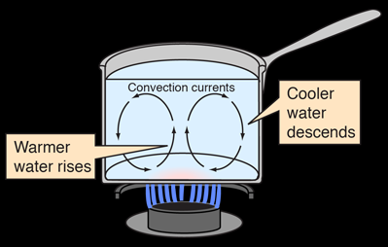
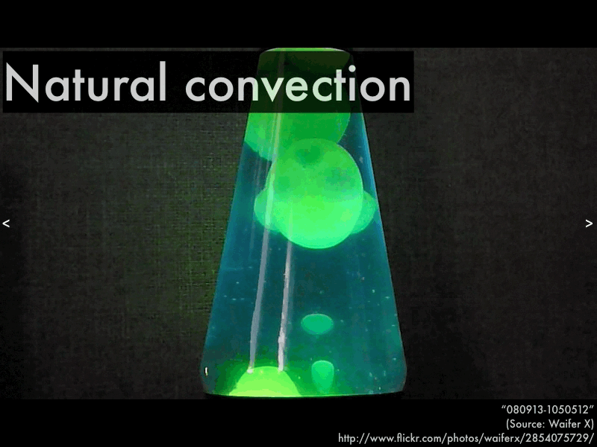
Why do tectonic plates move?
Convection
Fluids do not heat evenly. Some of a fluid can be warmer and less dense, while some is cooler and more dense.
The warmer, less dense fluid rises
The cooler, denser fluid sinks.
The circulation within fluids caused by differences in density and thermal energy is called convection.

Slide 22
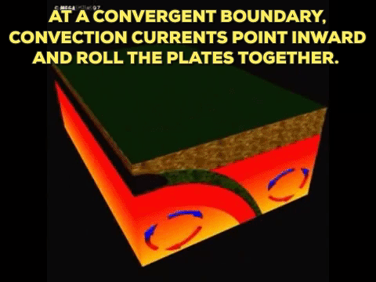
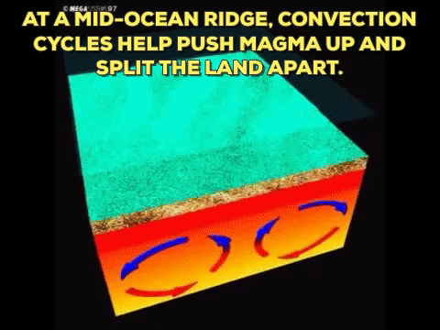
Convection occurs in Earth’s asthenosphere, the layer just below the lithosphere.
Convection in the mantle can drag plates over the surface of Earth
As the mantle convects, it pulls and pushes the tectonic plates.

